Slide 1
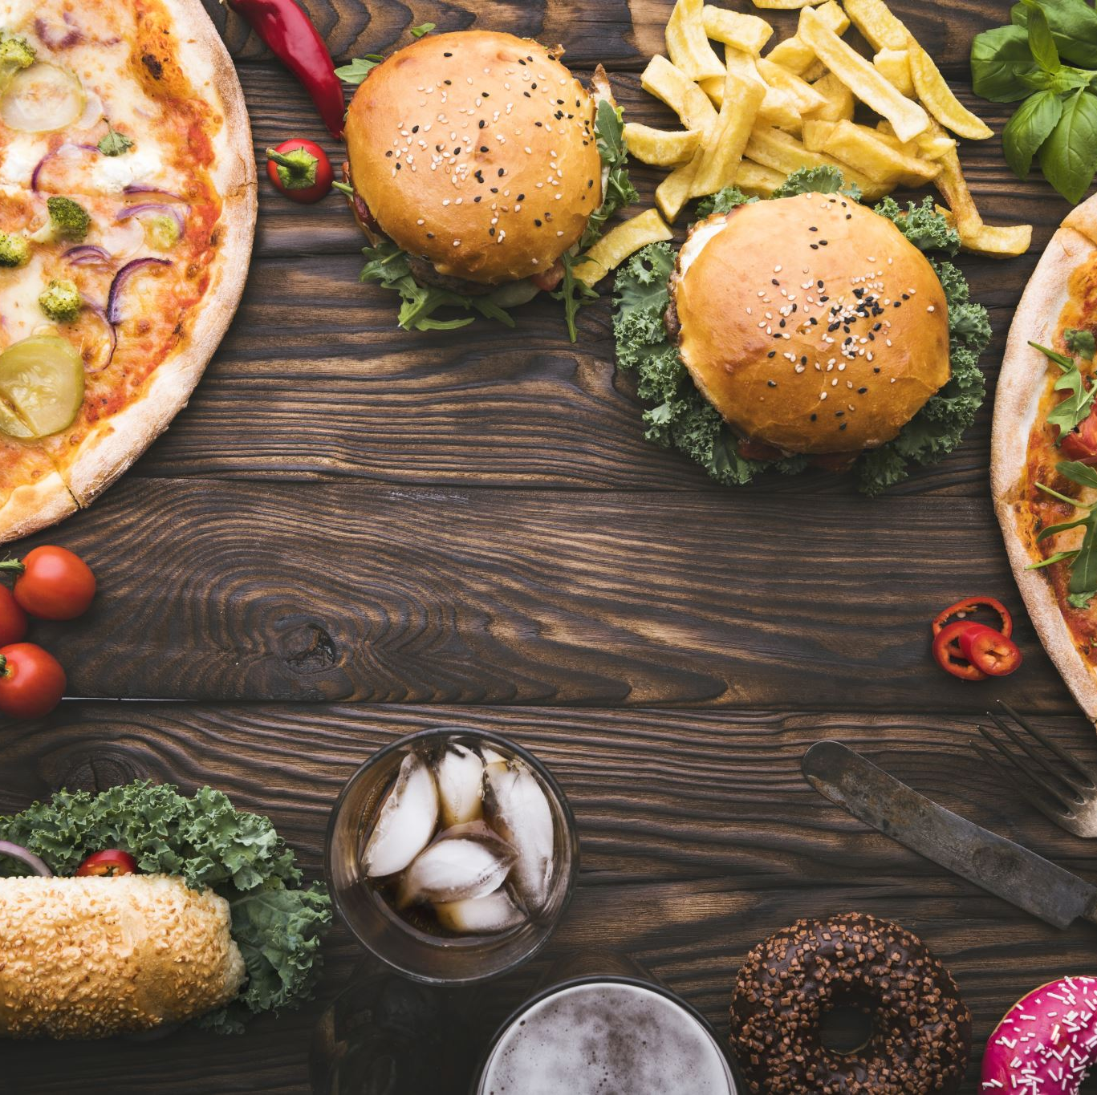
Predicting High-Traffic Recipes
Leveraging Machine Learning for Recipe Recommendation on Website
Date: 10-Feb-2024
Presented by: Romuald Tcheutchoua,
Data Scientist Professional

Slide 2
Introduction
Introduction to the Project and Business Goals
Objective: To accurately predict high-traffic recipes for website recommendations.
Business Goal: Increase user engagement and traffic on the platform by providing relevant and appealing recipe suggestions.

Slide 3
Project overview
Project Scope
Data Science Approach: Classification modeling to predict high-traffic recipes.
Data Sources: Dataset containing recipe information including nutritional content, category, servings, and high-traffic status.
Models Evaluated: ExtraTreesClassifier, GradientBoostingClassifier, RandomForestClassifier, and 4 others.

Slide 4
Summary of work
Work Undertaken
Data cleaning and Preprocessing: Handling missing values, data type conversion, outlier removal, and feature engineering.
Exploratory analysis: Univariate,Bivariate, Multivariate, hypothesis testing
Model Training: Training and evaluating seven classification models using cross-validation.
Model Selection: Baseline model (ExtraTreesClassifier) and comparison model chosen based on performance metrics.
Notes:
Graph showing ‘High’ and ‘Low’
Graph ’High’ and category

Slide 5
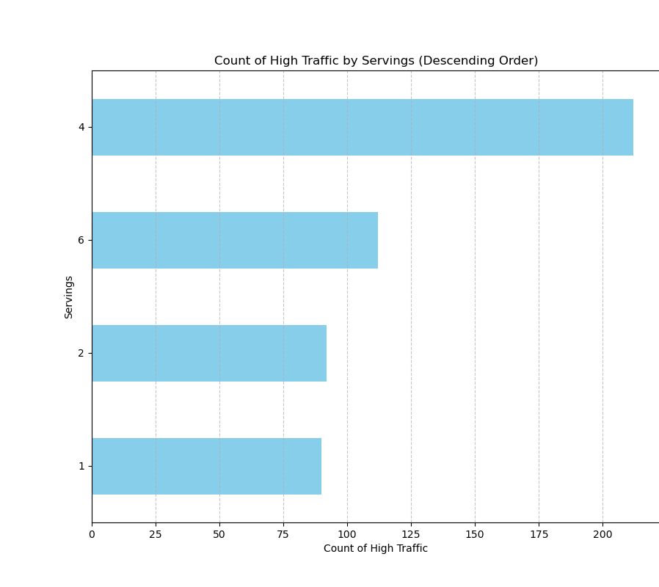
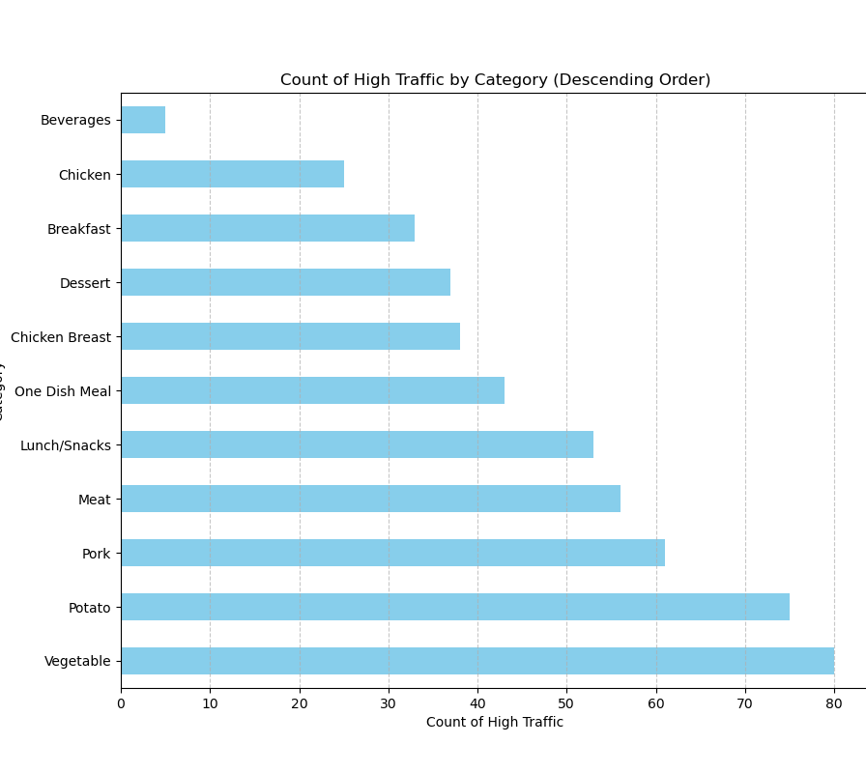
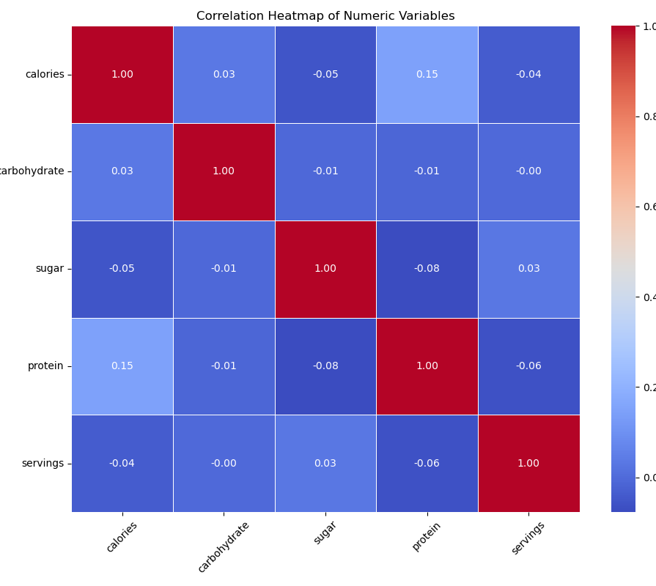
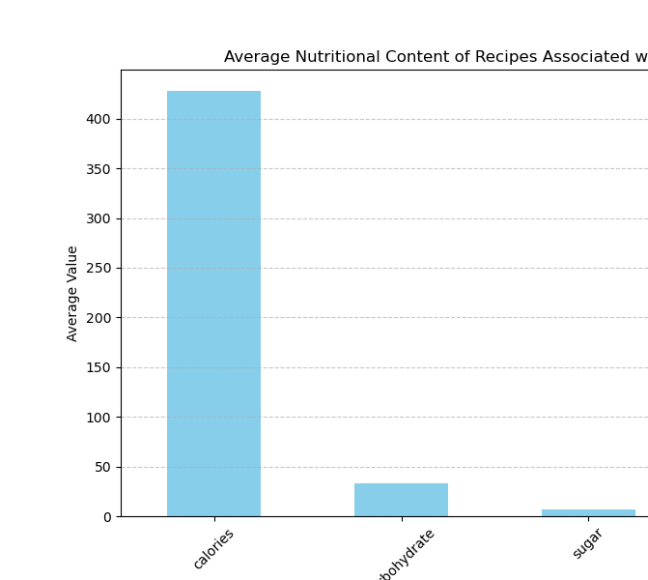
Key findings
Distribution of Nutritional Values: Overview of calories, carbohydrate, sugar, and protein content in recipes leading to high traffic
Category Analysis: Popular recipe categories and their impact on traffic.
Correlation among nutritional content and with servings
Serving Sizes: Influence of serving sizes on recipe popularity and traffic generation.
Evaluation Metrics: Precision for identifying high-traffic recipes selected as the primary metric.

Slide 6
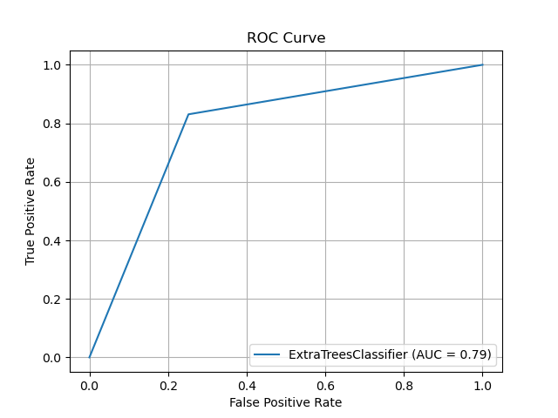
Model performance
Baseline Model (ExtraTreesClassifier):
Training Accuracy: 99%
Prediction Accuracy: 79%
Precision for High Traffic: 80%
Comparison Model:
GradientBoostingClassifier:
Training Accuracy: 88%
Prediction Accuracy: 77%
Precision for High Traffic: 78%

Slide 7

Metric to monitor
Metric: Precision for Identifying High-Traffic Recipes
Definition: Proportion of correctly predicted high-traffic recipes out of all recipes predicted as high-traffic by the model.
Current Estimation: Baseline model achieves 80% precision, while comparison model achieve 78% precision.

Slide 8
Recommendations
Monitor
Continuously monitor precision for identifying high-traffic recipes to ensure model effectiveness.
Consider
Consider retraining the model periodically with updated data to maintain accuracy and relevance.
Explore
Explore additional features or data sources to further enhance predictive performance.

Slide 9
Next Steps
Implement recommendations to improve model performance and business outcomes.
Collaborate with data science team to refine model and explore advanced techniques.
Deploy the baseline model to production and measure its impact on user engagement and traffic.

Slide 10
Typo code mistakes in my published Markdown
Please consider instead this code in the relevant section in my published Markdown:
## Let’s make sure that all values in calories, carbohydrate, sugar, protein to have only 2 decimal (this section comes just after ‘## filling the missing values’)
df['calories'] = df['calories'].round(2)
df['carbohydrate'] = df['carbohydrate'].round(2)
df['sugar'] = df['sugar'].round(2)
df['protein'] = df['protein'].round(2)
The code is correctly written in the code section but I mistakenly included a conversion to string in my published Markdown.

